Slide 1




Click to Add Cover Title
Max 3 Lines
JH&P AI-Embedded
Client Onboarding
Demo Takeaway
Speaker Name
Lucia Ribot | Solution Consultant | lucia.ribot@appian.com
Date
October 2026

Slide 2
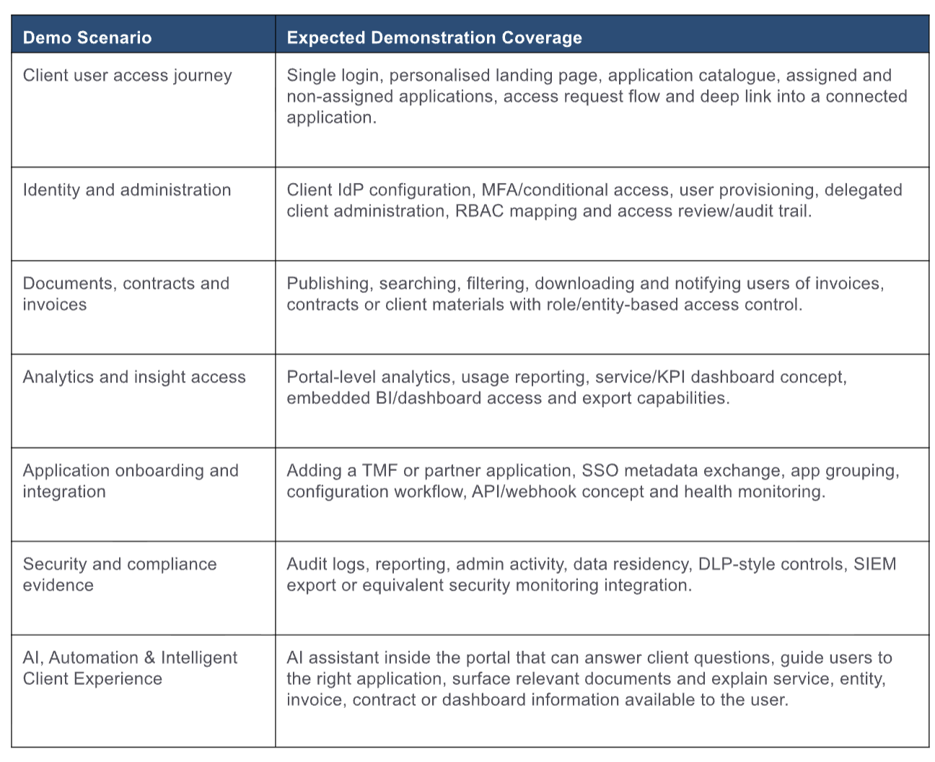
James Hambro & Partners | RFI requirements shown in the demo
RFI area | What the demo showed | Where
4.1 Client experience | Branded client portal replacing the 44-page form: six tailored sections, save-and-resume, validation and dynamic questions | JH&P Portal
4.2 Integration and data | Pre-population from Xplan, Companies House lookup, write-back to Pulse, Symphony and Xplan on approval, sync status per system | Portal, Onboarding, Portfolio
4.3 Workflow and configurability | Guidance, tooltips, options, thresholds and risk weights changed by the business with no release | Onboarding · Settings
4.4 Operational efficiency | Live queue with SLA warnings, items that need a person, guarded send for approval | Onboarding
4.5 KYC/AML and access | Screening provider check, AI recommendation, human decision, four-eyes approval, masked identifiers by role | Onboarding · Portfolio
4.6 Document processing | Appian DocCenter extraction and reconciliation; AI-raised mismatch against the declared value | Onboarding
4.7 AI and agents | Client onboarding assistant, case assistant and screening agent (Appian AI agents), AI-drafted case summary | All three sites
4.8 Reporting and MI | Live onboarding performance, back-office sync health and where AI is used and checked | Onboarding · Reports
4.9 Multi-party | Joint applicant, company directors and advisers, each completing their own part in parallel | Portal, Onboarding
4.10 Communication | Secure messages, handoff from the assistant to a person, client told when accounts open | Portal, Onboarding

Slide 3
01
Client Application Journey
Rebecca Hartley-Vance completes her application on the JH&P Portal: tailored sections, validation, a joint applicant and the family company, source of wealth, the in-line AI assistant, evidence upload and signing.
‹#›

Slide 4
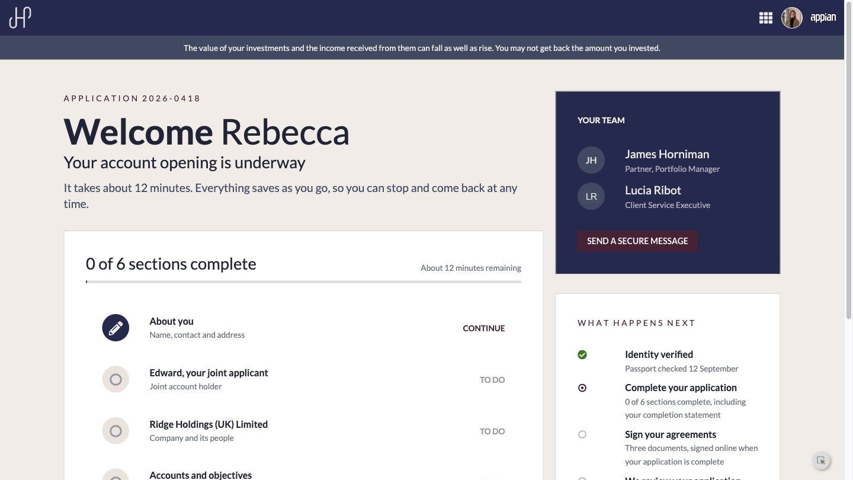
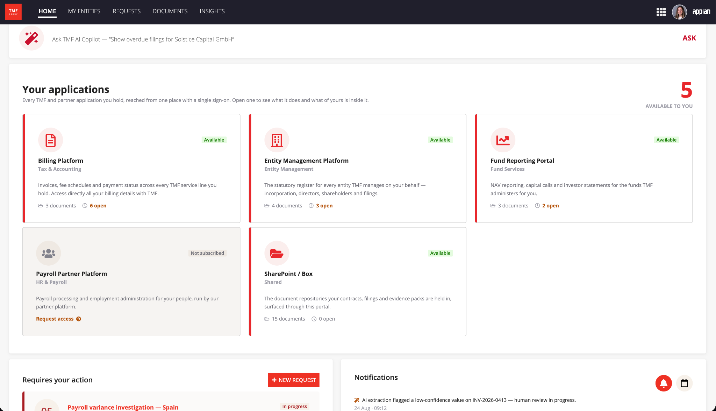
Client portal home
Progress, team and what happens next
As a client, I want to see where my application stands and who is looking after me, so that I never have to chase JH&P for an update.

Slide 5
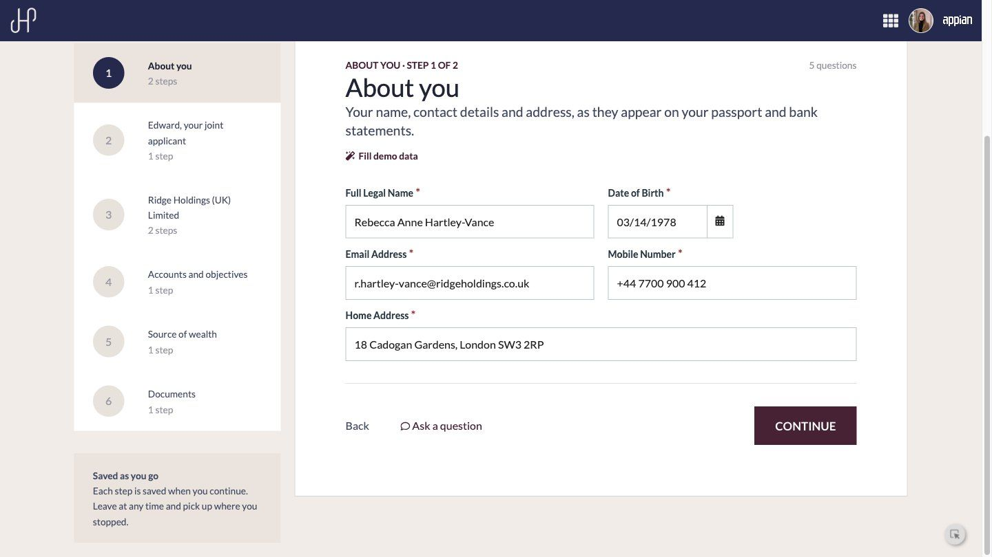
Validated as she types
About you
As a client, I want mistakes caught while I type, so that my application is not sent back to me later.

Slide 6
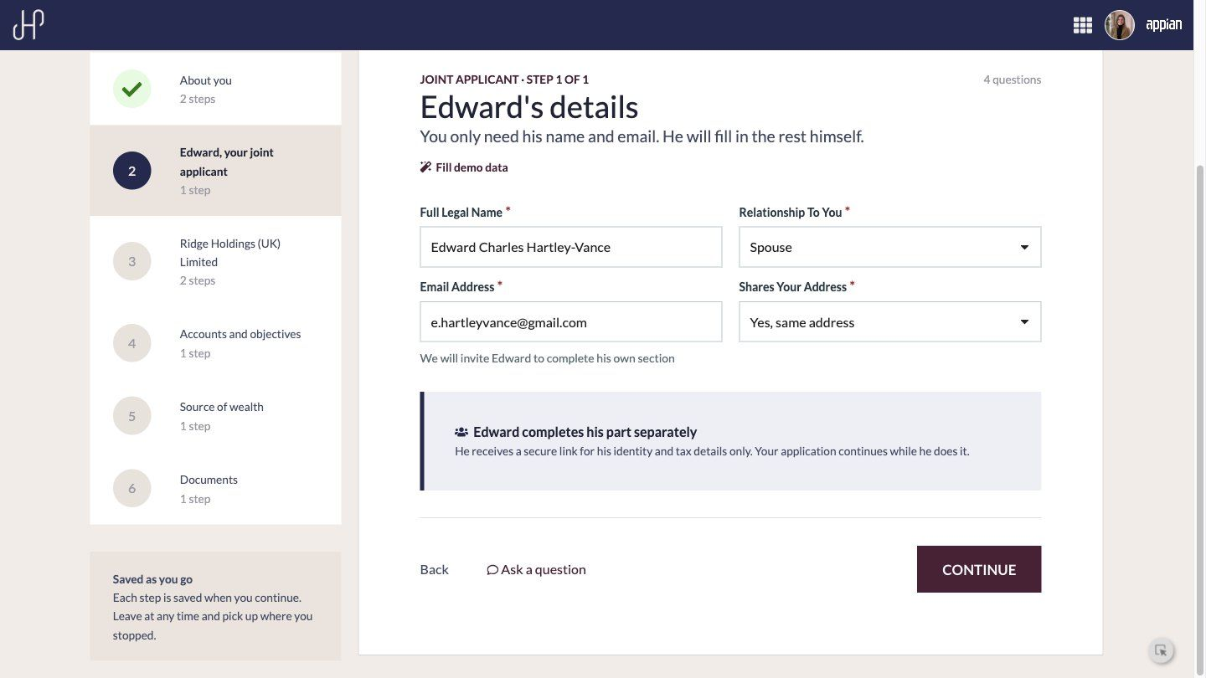
Joint applicant
Parties complete their own part in parallel
As a client opening a joint account, I want Edward to complete his own section on his own link, so that I am not held up while he is travelling.

Slide 7
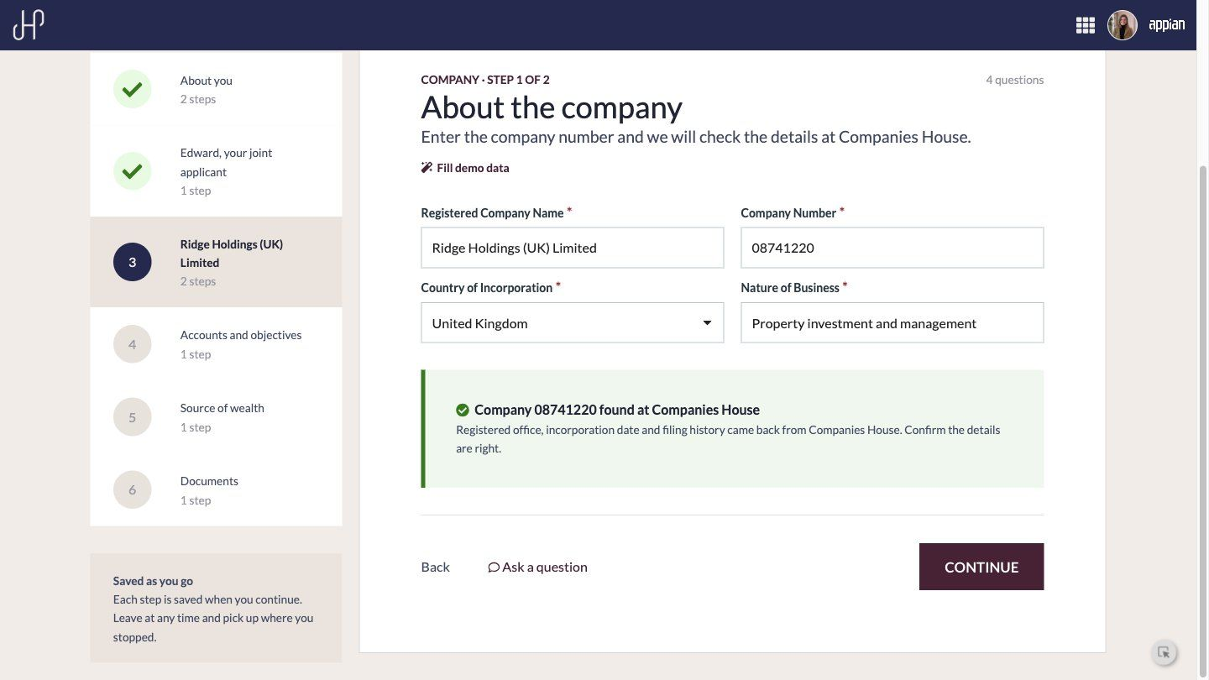
The family company
Checked against Companies House
As a client service executive, I want company details confirmed against Companies House, so that nobody rekeys them.

Slide 8
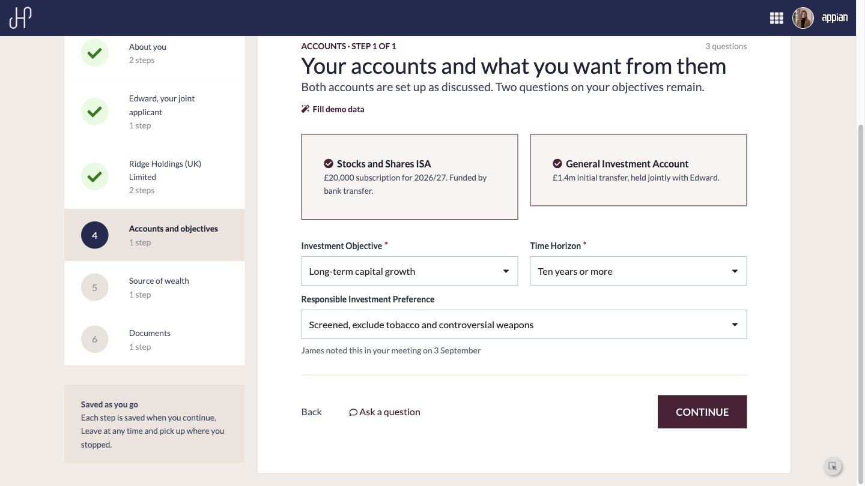
Accounts and objectives
Pre-filled from the first meeting

Slide 9
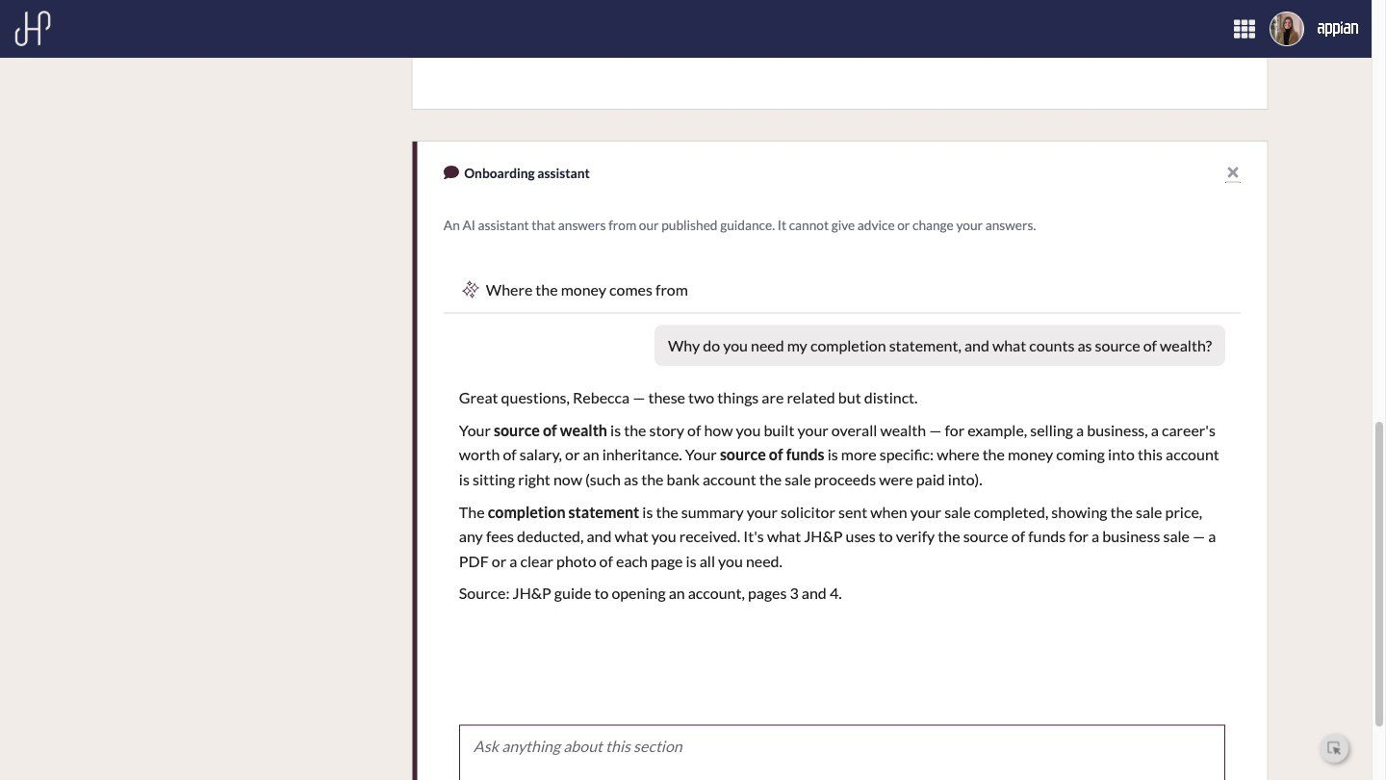
Onboarding assistant
Appian AI agent, scoped to the section
As a client, I want to ask what a question means without leaving the form, so that I can finish in one sitting. The assistant answers only from JH&P guidance, cannot give advice and hands off to a person.

Slide 10
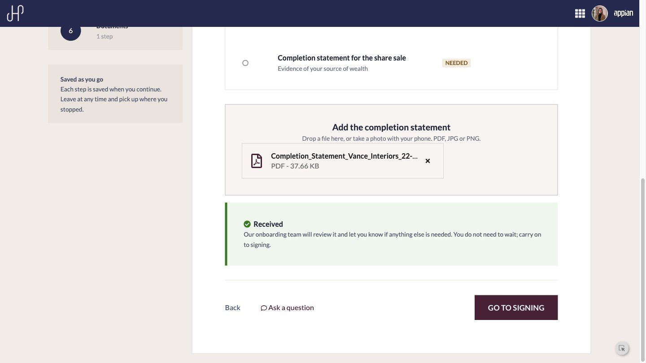
Evidence upload
Completion statement received and sent to DocCenter
As a client, I want to upload one document and carry on, so that I am not waiting for it to be checked.

Slide 11
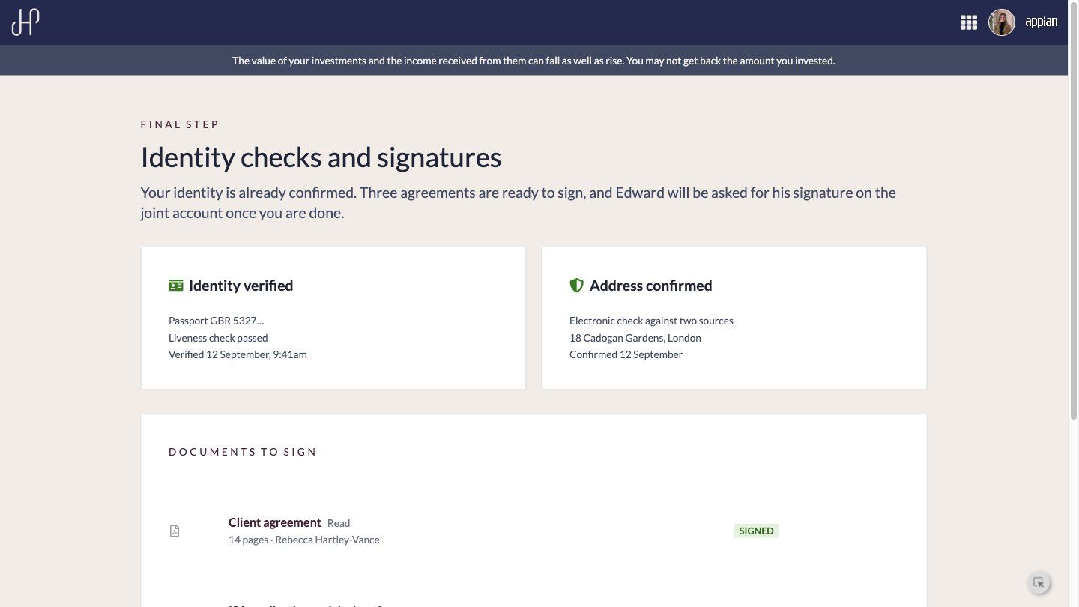
Identity checks and signatures
Three agreements signed online

Slide 12
02
The Onboarding Team
The client service executive picks up the submission: the live queue, plain-English questions to the case assistant, and the full case in one place.
‹#›

Slide 13
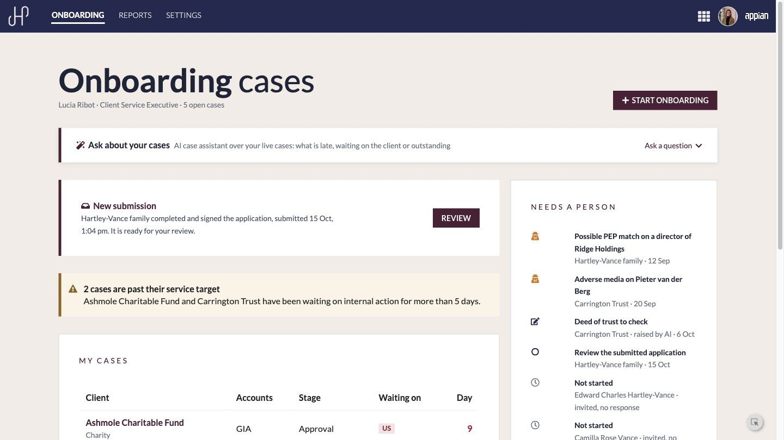
Onboarding queue
New submissions, SLA warnings and what needs a person
As a client service executive, I want my day laid out for me, so that late cases and new submissions are never missed.

Slide 14
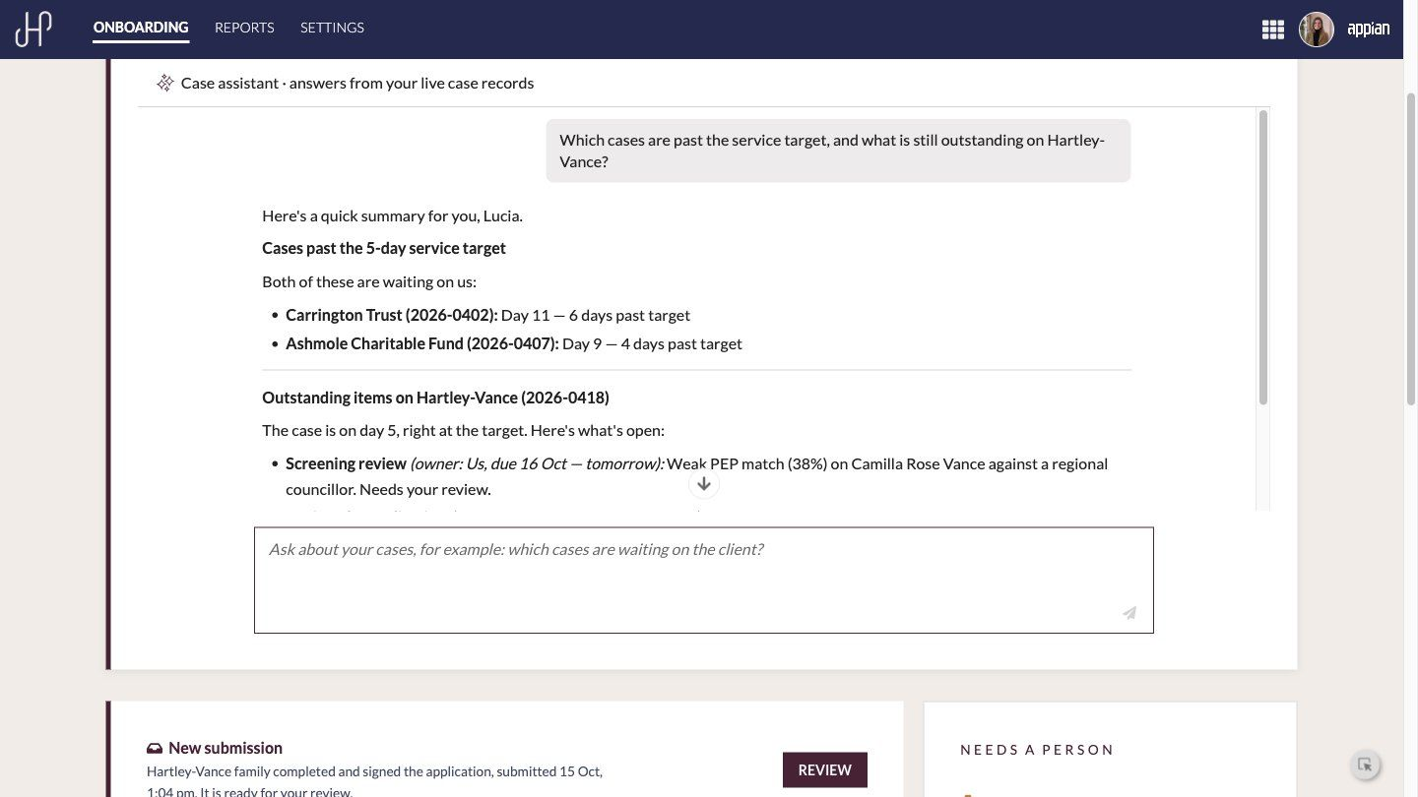
Case assistant
Plain-English questions about live cases
As a client service executive, I want to ask which cases are late and what is outstanding, so that I do not have to build a report to find out.

Slide 15
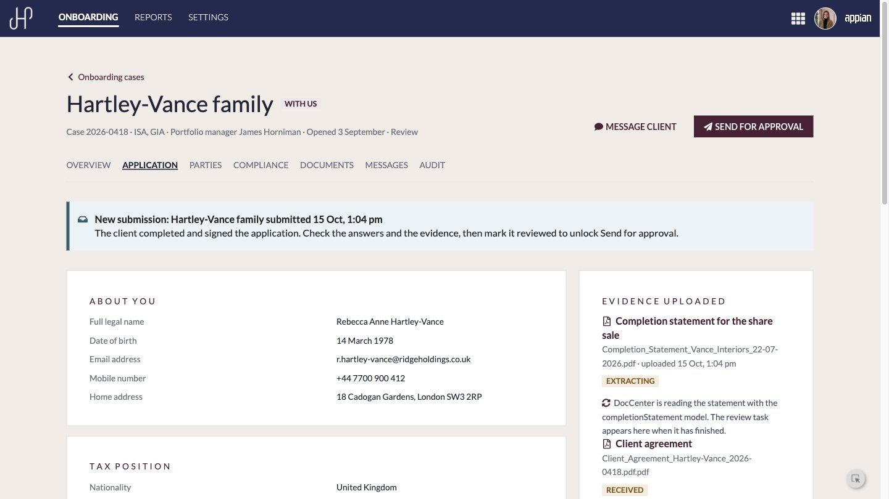
Application tab
Everything the client gave, read-only, beside the evidence

Slide 16
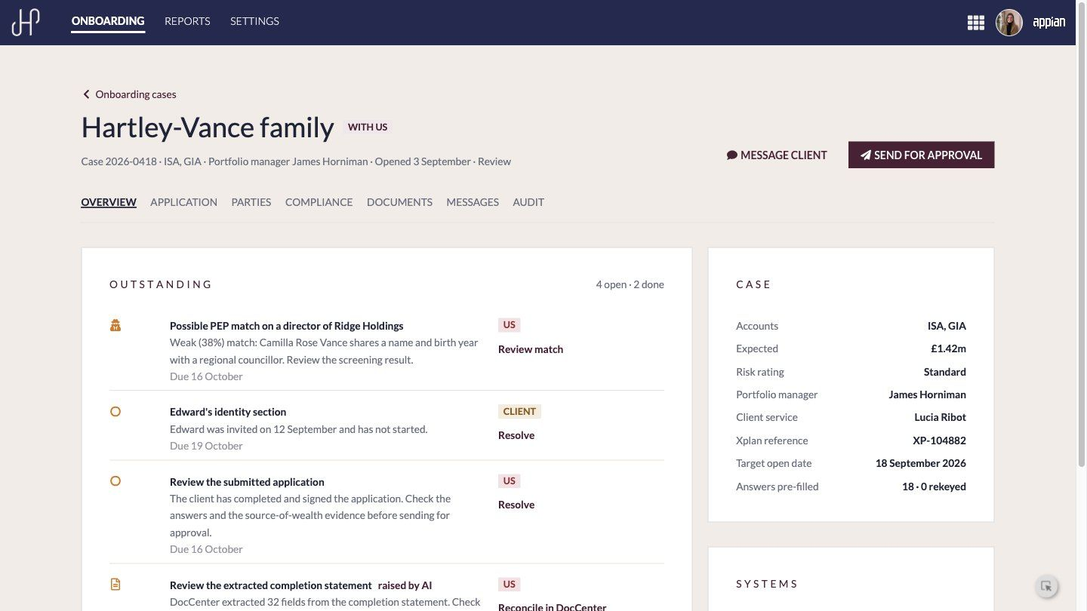
Case overview
Outstanding items with owner, due date and action

Slide 17
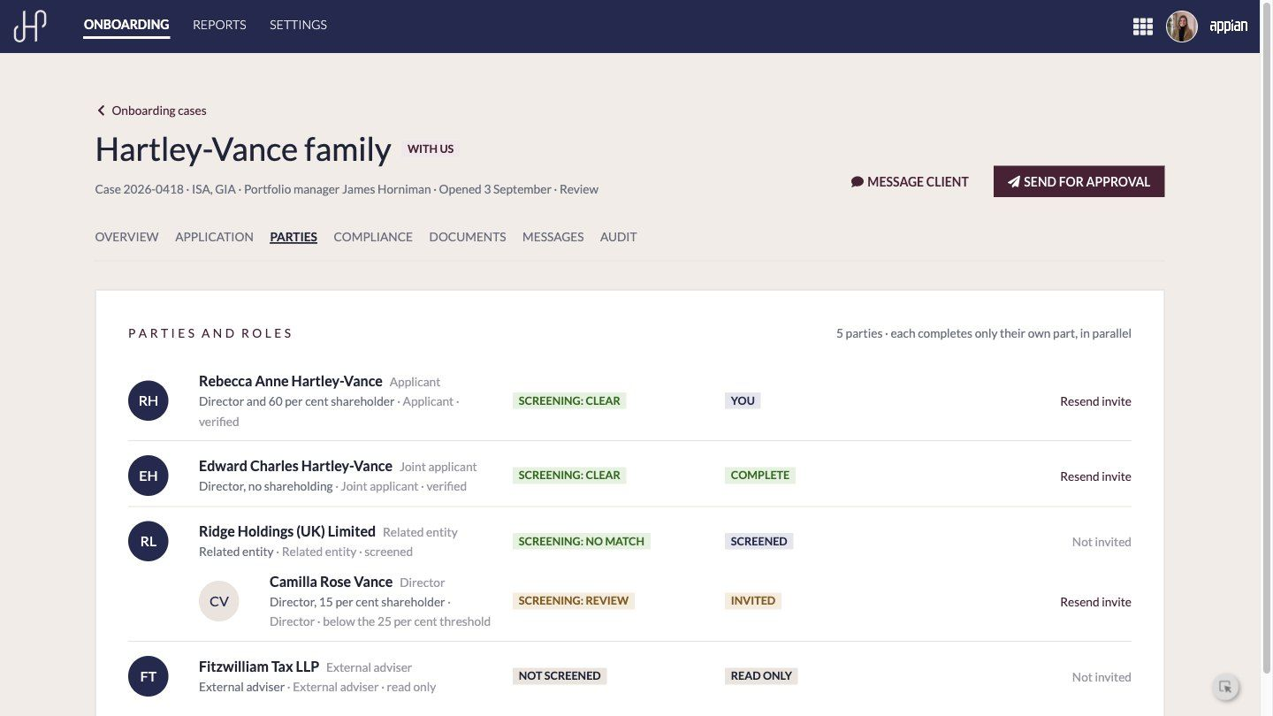
Parties
Multi-party onboarding with screening and invite status

Slide 18
03
KYC and Screening
A possible PEP match on a director: provider check, the screening agent's recommendation and a human decision with four-eyes approval.
‹#›

Slide 19
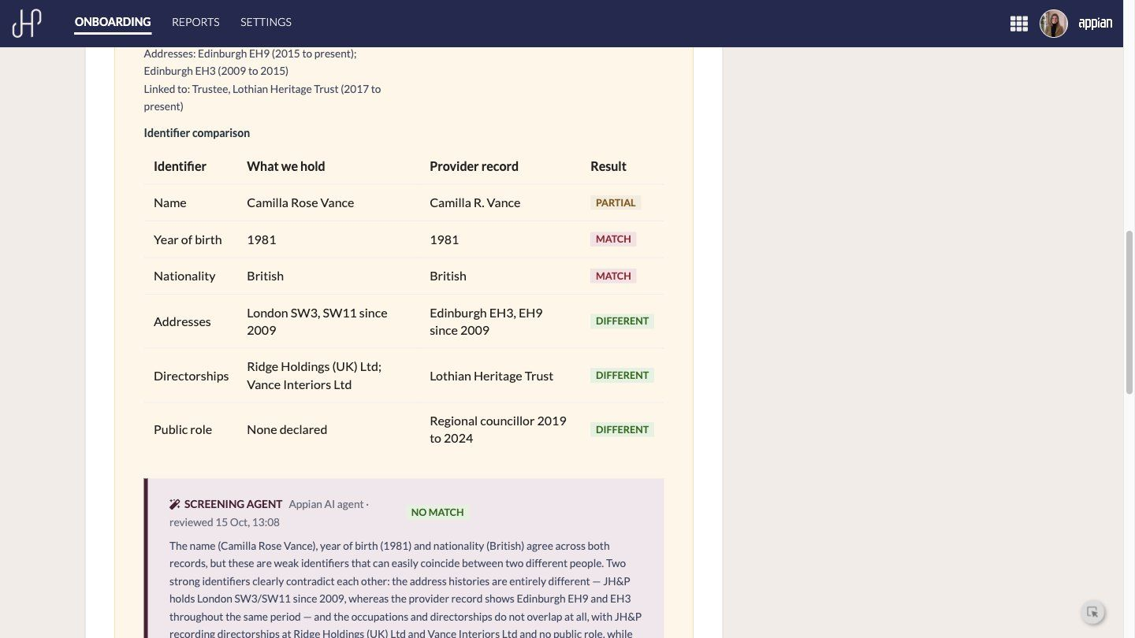
Identifier comparison
What we hold against the provider record

Slide 20
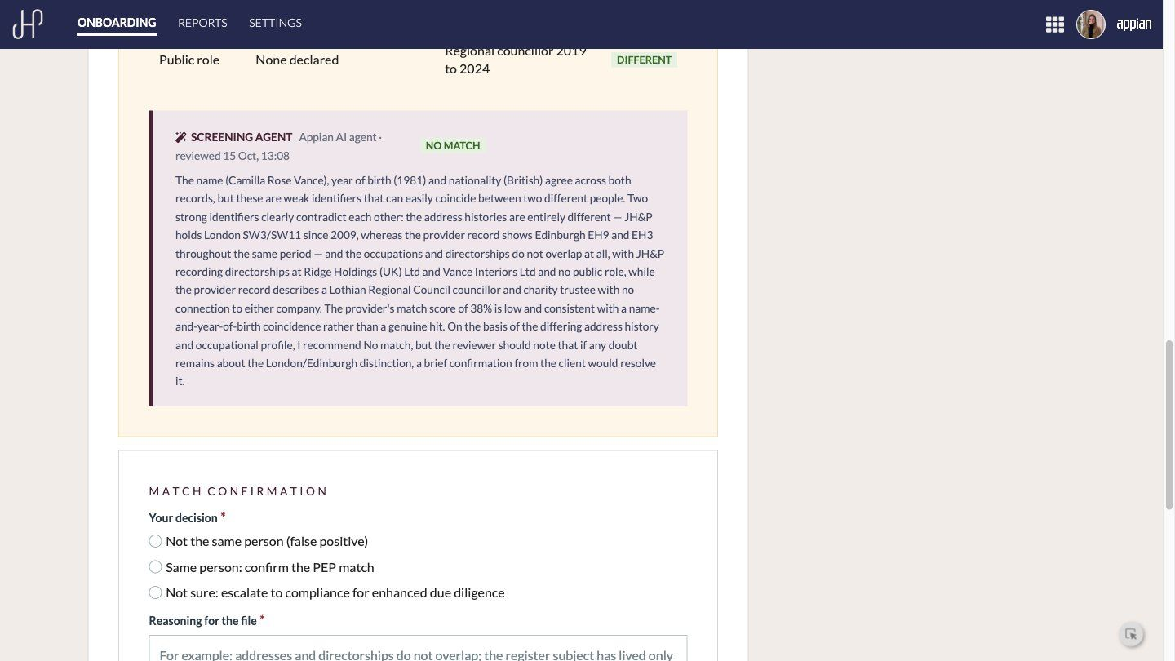
Screening agent
The agent advises; a person decides
As a compliance-minded CSE, I want the AI to compare every identifier and explain its recommendation, so that I decide faster without handing the decision to a machine.

Slide 21
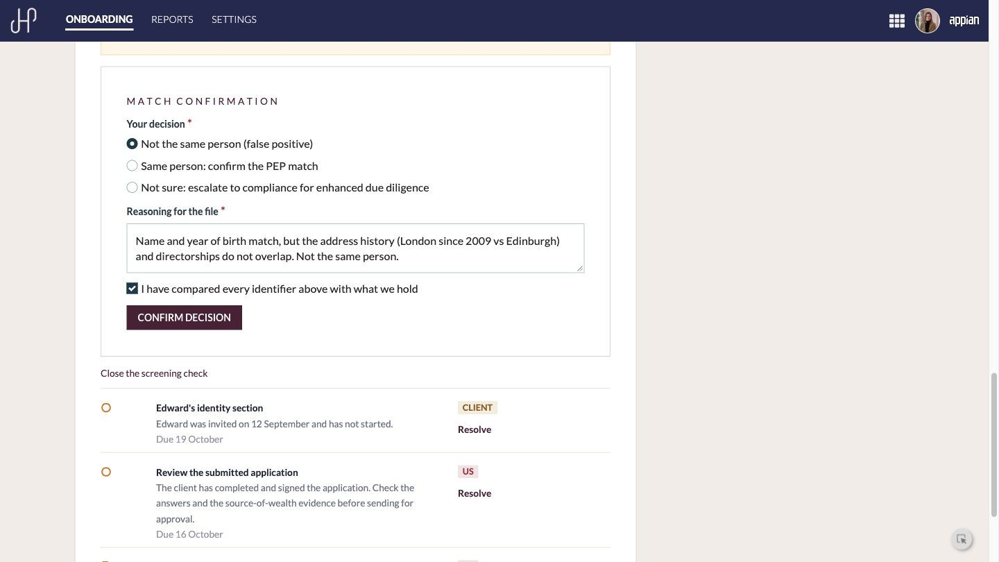
Match confirmation
Decision, reasoning and confirmation, all required

Slide 22
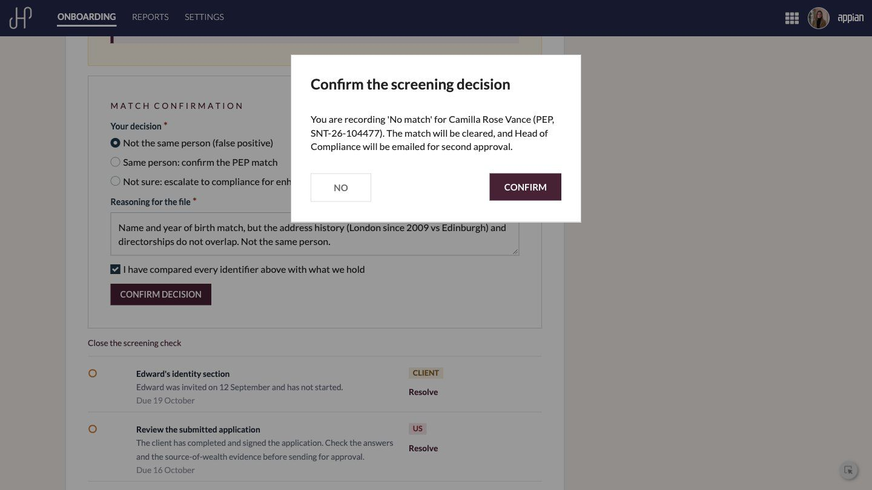
Second approval
Head of Compliance emailed for four-eyes approval
As Head of Compliance, I want every screening decision countersigned by a second person, so that segregation of duties is enforced, not assumed.

Slide 23
04
Document Intelligence
Appian DocCenter reads the completion statement, the team reconciles the fields, and a mismatch with the declared value is raised automatically.
‹#›

Slide 24
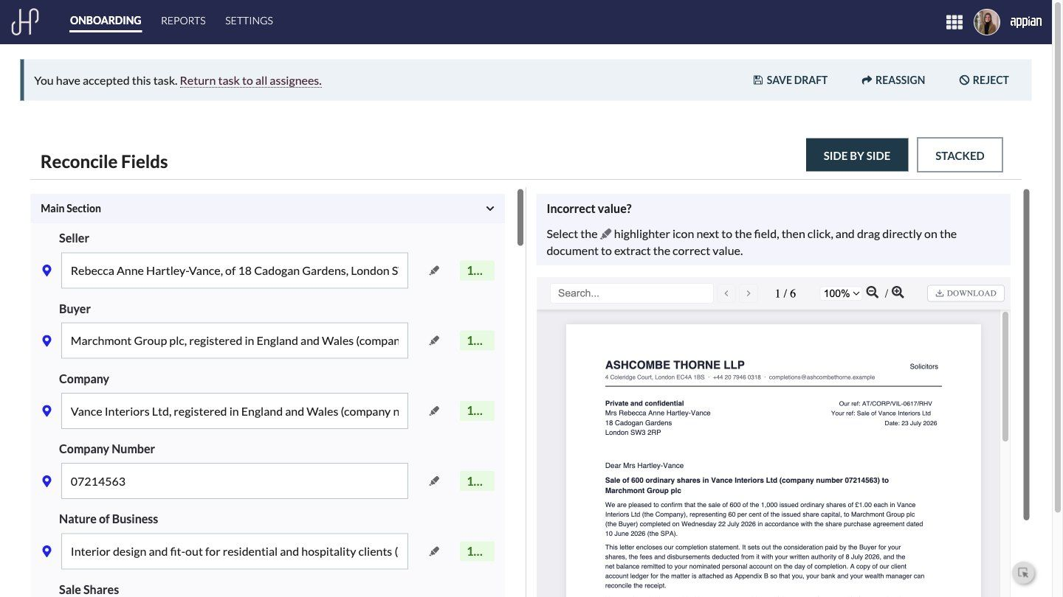
DocCenter reconcile
32 fields extracted, side by side with the document
As a client service executive, I want extracted values beside the document with their confidence, so that I check rather than retype.

Slide 25
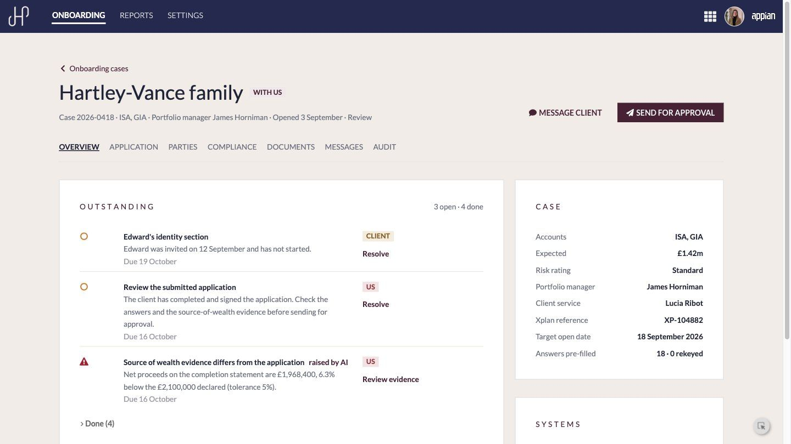
Mismatch raised by AI
Net proceeds 6.3% below the declared value

Slide 26
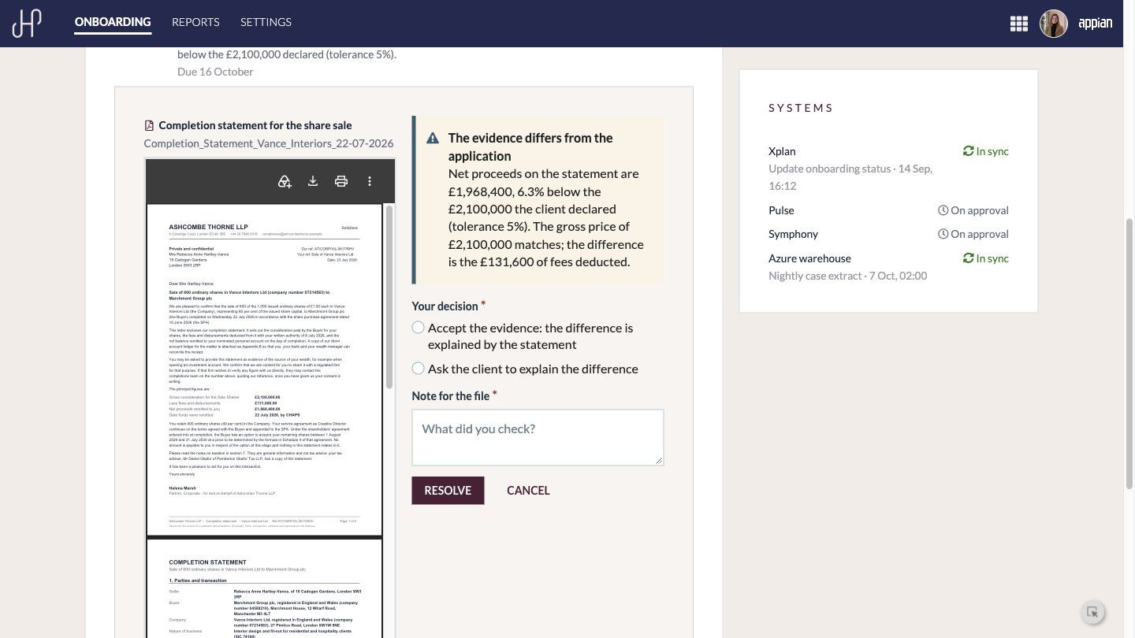
Review the evidence
Document beside the decision

Slide 27
05
Approval and Accounts Opened
The case goes to James Horniman on the JH&P Portfolio site. One approval writes back to Pulse, Symphony and Xplan and tells the client.
‹#›

Slide 28
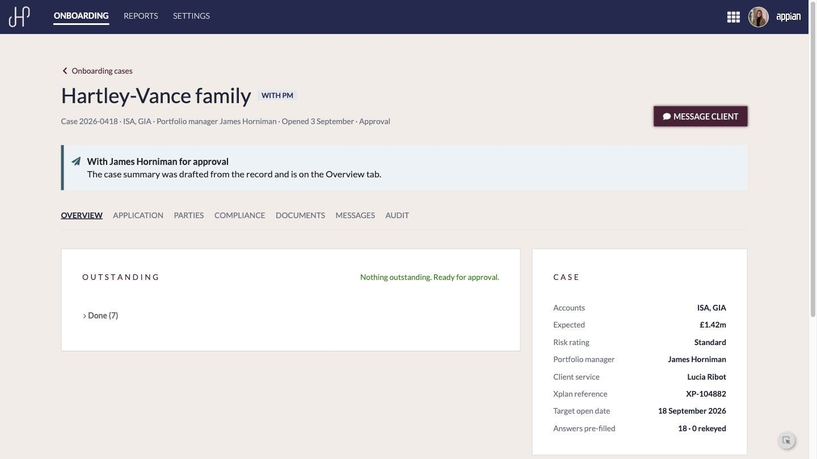
Ready for approval
Guarded send, AI-drafted case summary

Slide 29
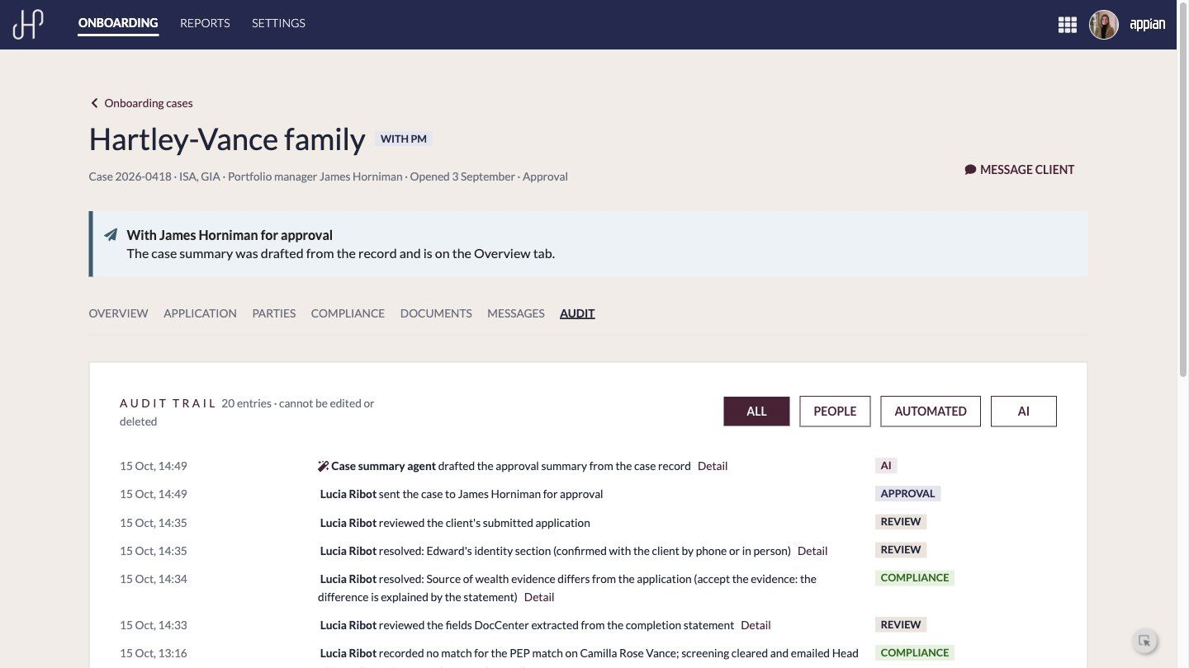
Audit trail
People, services and AI, with reasoning

Slide 30
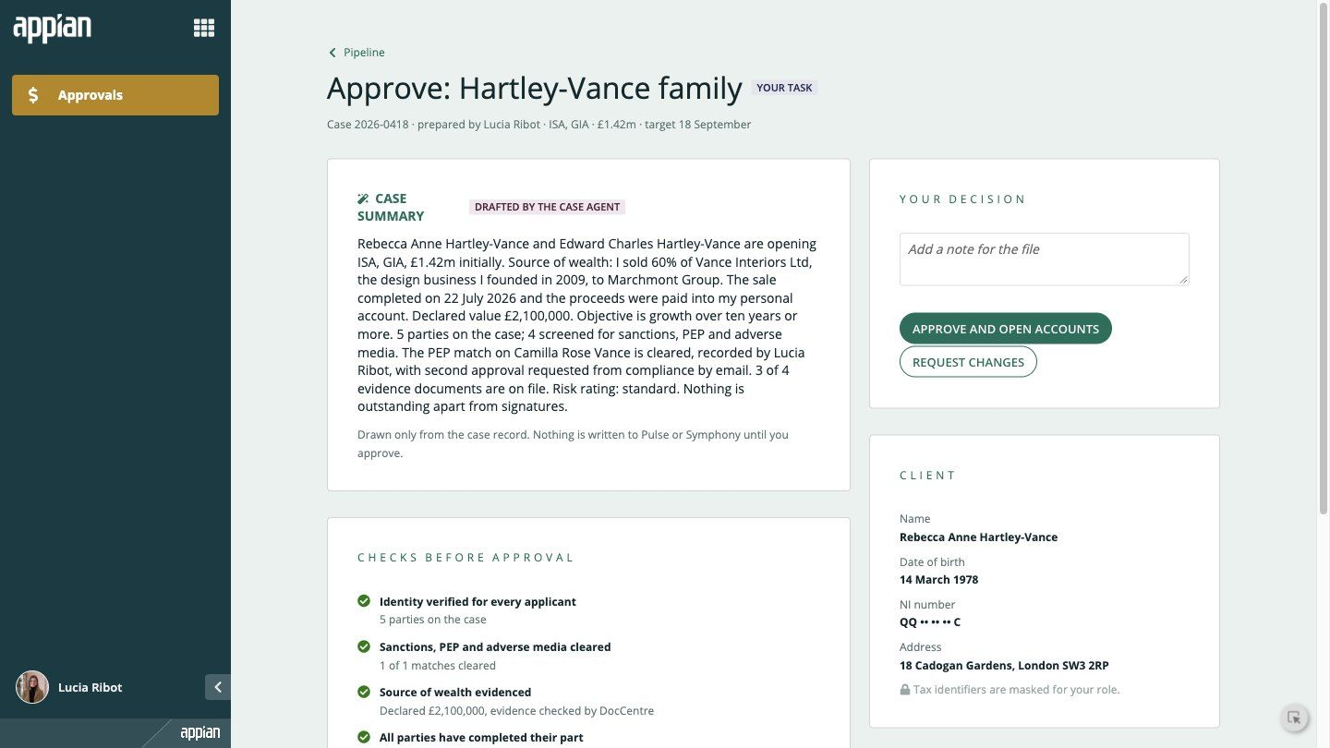
Portfolio manager approval
JH&P Portfolio site: summary, masked identifiers and computed checks
As a portfolio manager, I want the case summarised and every check worked out for me, so that I can approve with confidence in minutes.

Slide 31
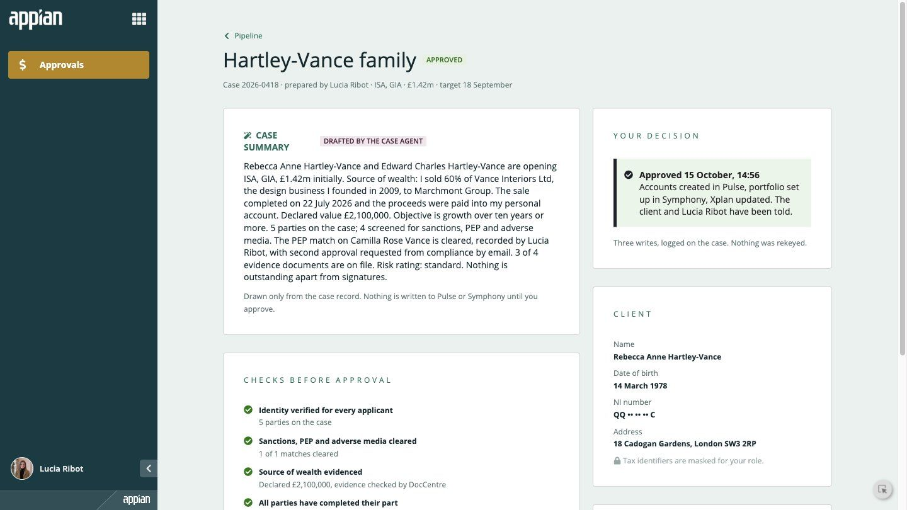
Approved
Accounts created in Pulse, portfolio in Symphony, Xplan updated

Slide 32
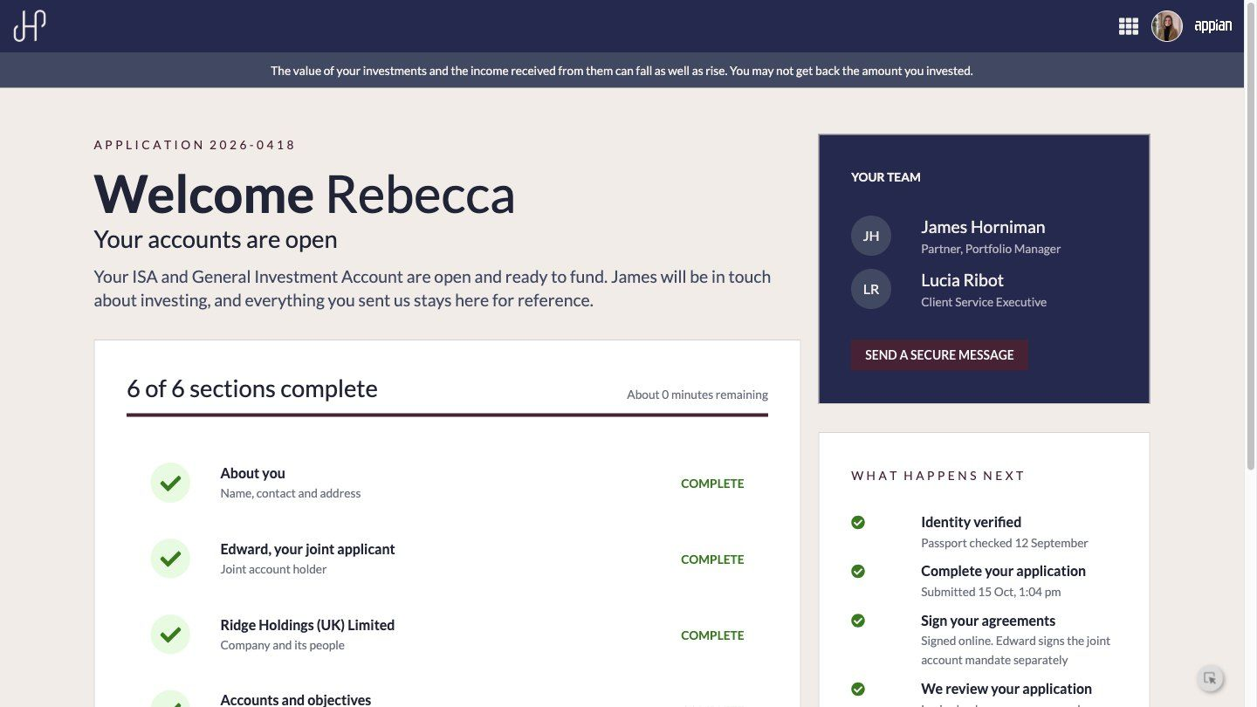
Client informed
Rebecca sees her accounts open

Slide 33
06
Reporting and Configuration
Live onboarding MI, and the settings the business changes itself with no release.
‹#›

Slide 34
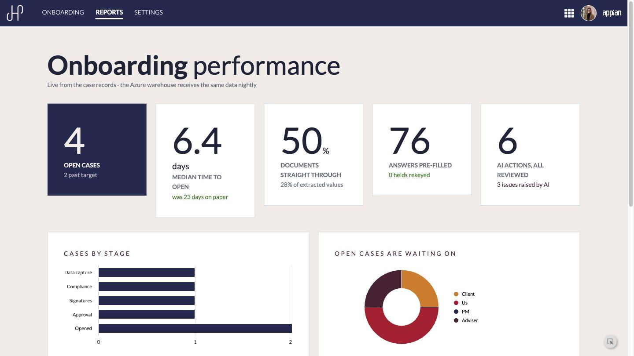
Onboarding performance
Computed live from the case records

Slide 35
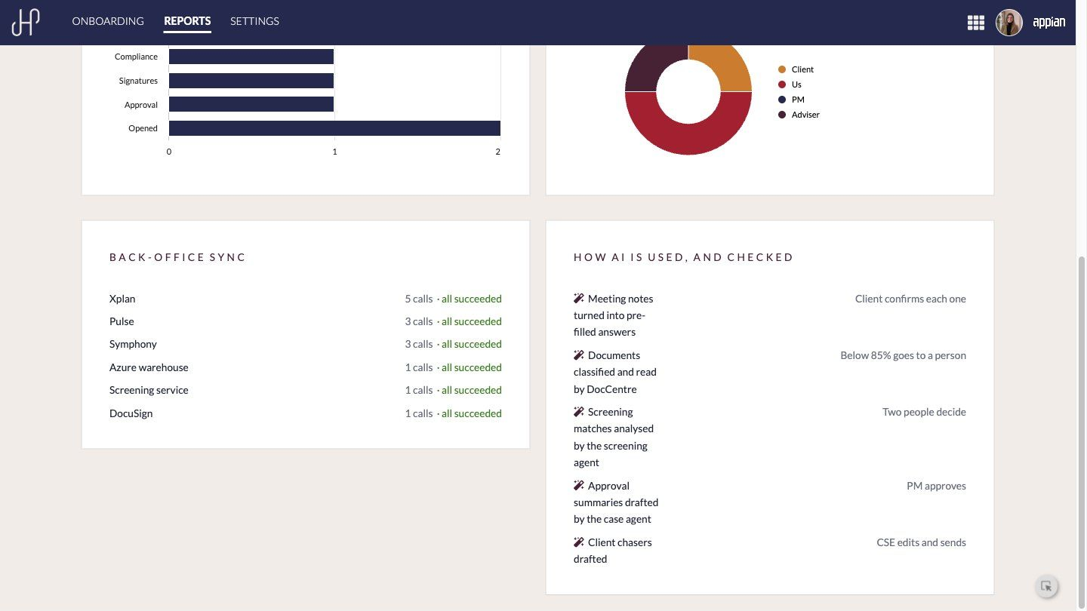
Sync health and AI use
Where work waits and where AI is used and checked

Slide 36
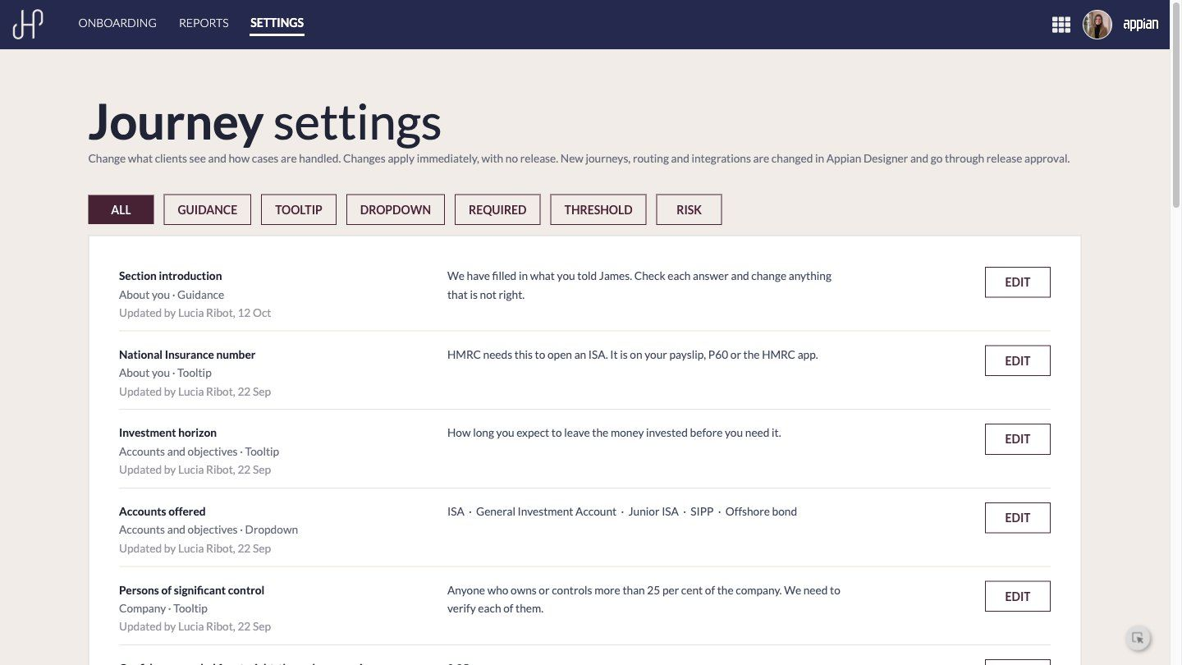
Journey settings
Changed by the business, with no release
As an onboarding lead, I want to change guidance, options and thresholds myself, so that the journey keeps up with the business without a project.

